Slide 2
PITCH DECK
Wolff Olins
Presentation 1

Slide 3
PITCH DECK
Wolff Olins
Presentation 1

Slide 4
BUILD YOUR FUTURE
Firefox OS for OEMs

Slide 5
FIREFOX IS A CATALYST FOR INDIVIDUAL AND COLLECTIVE PROGRESS

Slide 6
MAIN HEADLINE: 36PT OPENS SANS EXTRABOLD ITALIC
Body text in Open Sans 24 pt. Line spacing is set on single.
Use Bold to highlight an important point.
Use full returns between paragraphs of information. Keep it simple: don’t use bullet points for every thought.

Slide 7
HEADLINE FOR TEXT SLIDE CAN BE ONE OR TWO LINES
Avoid starting your presentation text with bullets.
Use them when you need to drill down into the full details of your main points.
Separate main points with a full return.
Avoid text that goes all the way across the page: it’s hard to read. Use the ¾ mark in the grid as the maximum width of your paragraphs (the Master pages are already set up this way).
— Use an “M” dash for all levels of bullets

Slide 8
KEEP YOUR HEADLINES SHORT AND TO THE POINT
You can also use half of the page when you need to show images and text.
Use the grid to size, align and keep space between the images.
Can’t see the grid? Right-click an empty area of the slide or the margin around the slide, point to “Guides,” then click “Static Guides.”

Slide 9
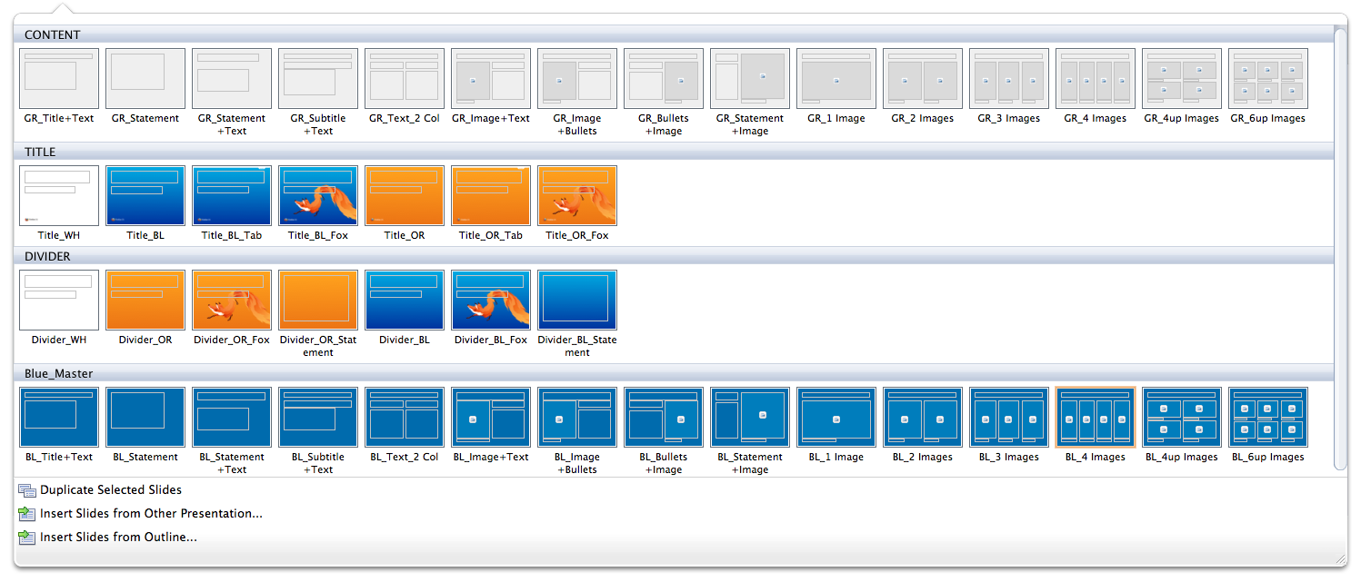
THIS DOCUMENT IS SET UP WITH MASTER PAGES
Use the pull-down menu on the New Slide button on the Home tab to choose from the four available Master pages:
Content
Title
Divider

Slide 10
FIREFOX
21% MARKET SHARE
450+ MILLION USERS
OVER 80 LANGUAGES
Now, were going mobile…

Slide 11
WHO’S IT FOR?
THE NEXT BILLION
SMARTPHONE CUSTOMERS
Giving rapidly emerging markets (with focus on Latin America)
a rare opportunity to leapfrog

Slide 12
STAY LEAN
No software license fees
No restrictions on ways to monetize apps
Less time and costs spent to transfer apps across platforms and devices (due to transferable HTML5 language)
LOWER COSTS
BIGGER MARGINS
MORE EFFICIENCY

Slide 13
MOZILLA
A unique passion-driven non-profit project since 1998
Pioneers & defenders of open Web for all
Giving people choice & control over their online lives
Bringing together a vast community of developers

Slide 14
WE’VE ALWAYS FOUGHT TO KEEP THE WEB OPEN SO INNOVATIVE AND CREATIVITY CAN FLOURISH
Imagine, a billion people experiencing he daily inspiration of carry the web in their pockets – for the first time.
A billion new perspectives.
A billion new opportunities.
A billion individuals seeking to connect and converse and grow in a a billion intersecting ways.
With Firefox OS, we’re making it possible for a billion more people to take full advantage of the Web. Offering them the freedom to blaze their own trails, amplify their voices, control their destinies, and transform the future.

Slide 15
DELIVER INNOVATION
Providing customers with a new, faster, more intuitive way to access content on their mobile device:
FROM
TO
Separating web and apps, creating a clunky user experience
Limiting customer access to content by imposing strict rules on creativity and monetization of apps
Seamlessly integrating web and apps
Pre-loading 30,000 apps & tapping the creativity of over 8 million app developers without limitation

Slide 16












PARTNERS

